Slide 1
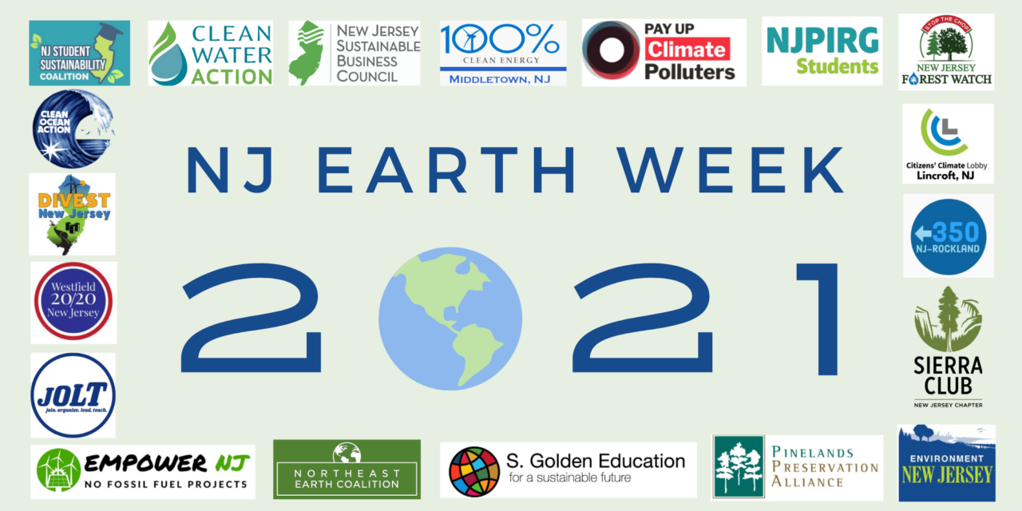
GREEN YOUR TOWN
YOUR Path to Clean Energy & Green Life
Pat and Steve Miller

Slide 2



Sierra Club
100% Committed
Our mission is to leave a legacy of a livable world for our children and grandchildren.

Slide 3

WHY WE WANT TO SAVE THE WORLD

Slide 4

THAWING PERMAFROST
COAL MINING
LANDFILLS
© 2017 Don Foley
Notes:
ID #3622.D - May be live-streamed, broadcast, and presented in-person, but may not be recorded or modified.
It comes from lots of different sources. It comes from landfills, from transportation, burning forest and crop land, animal agriculture; the permafrost is thawing and that's playing a role now.
DESCRIPTION: Graphic representation of major sources of greenhouse gas emissions
ADDITIONAL TALKING POINTS: The sun releases energy as radiation, which travels out as a ray or in a straight line in all directions.[1*]
The energy released is known as “the solar spectrum.”[1*]
This energy is comprised largely of three regions of the electromagnetic spectrum:
Ultraviolet energy (high frequency energy that is responsible for sunburns)
Visible energy (light)
Infrared energy (heat).[1*]
Nearly half of the solar energy that reaches the top of the Earth’s atmosphere is absorbed by the planet’s surface.[2*]
The average solar radiation striking the top of the atmosphere is 340 watts per square meter.[2*]
About 29 percent is reflected back into space.[2*]
About 23 percent is absorbed by the atmosphere.[2*]
About 48 percent is absorbed by the Earth’s surface.[2*]
The Earth’s surface releases more heat than it receives from the sun.[2*]
The planet’s surface releases heat equivalent to 117 percent of the incoming solar radiation (about 398 watts per square meter).[2*]
Greenhouse gases play an instrumental role in amplifying solar energy and retaining heat.[2*]
Greenhouse gases like CO2, methane, nitrous oxide, and water vapor are opaque to many wavelengths of outgoing thermal infrared energy.[2*]
Each blocks a particular wavelength of energy, absorbs it, and radiates about half back to earth and the other half towards space.[2*]
Some of the heat radiated downwards is absorbed again by the Earth and ultimately radiated back into the atmosphere.[2*]
This is how the Earth radiates more energy as heat than it receives as solar radiation.[2*]
This process of trapping and radiating heat keeps the Earth’s temperature stable.[3*]
The process raises the surface temperature to about 15 degrees Celsius (59 degrees Fahrenheit) on average.[3*]
This is more than 30 degrees Celsius warmer than surface temperatures would be if the Earth didn’t have an atmosphere.[3*]
In an ideal scenario, where the Earth’s energy system is unaltered and working as expected, the energy that escapes as heat is roughly equal to what comes in as solar radiation.[2*]
Ideally, this would mean approximately 340 watts of energy per square meter leaving our atmosphere.[2*]
Burning fossil fuels means greater concentrations of greenhouse gases have disrupted this process and put the Earth’s energy equilibrium out of balance.[4*]
Today, less average energy leaves the atmosphere than comes in.[4*]
Today, higher concentrations of greenhouse gases trap about extra 3 watts of incoming solar energy per square meter of the Earth’s surface.[4*]
While the amount of extra heat energy seems small on paper, it has a large effect over the entire planet.[4*]
The result is global warming.[4*]
By the end of 2018, the warming influence of greenhouse gases had risen 43 percent above the 1990 baseline.[4*]
REFERENCES:
[1*] Ed. Rob Garner, "Solar Irradiance," National Aeronautics and Space Administration, last updated November 27, 2017. https://www.nasa.gov/mission_pages/sdo/science/solar-irradiance.html
[2*] Thomas F. Stocker et al., “Climate Change 2013: The Physical Science Basis,” Contribution of Working Group I to the Fifth Assessment Report of the Intergovernmental Panel on Climate Change, Cambridge University Press, Chapter 2 (September 30, 2013): 165-185. https://www.ipcc.ch/site/assets/uploads/2017/09/WG1AR5_Chapter02_FINAL.pdf
[3*] NASA Earth Observatory, “The Atmosphere’s Energy Budget,” January 14, 2009. https://earthobservatory.nasa.gov/Features/EnergyBalance/page6.php
[4*] LuAnn Dahlman, “Climate Change: Annual Greenhouse Gas Index,” National Oceanic and Atmospheric Administration, September 26, 2019. https://www.climate.gov/news-features/understanding-climate/climate-change-annual-greenhouse-gas-index

Slide 5


The Cost of Carbon
Political Instability
Species Extinction
Floods & Mudslides
Melting Glaciers
$
$
$
$
$
$
Wildfires
Famine
Drought
Water Scarcity
Storm Damage
Ecosystem Loss
Ocean Acidification
Our Way of Life
Infrastructure Loss
Infectious Diseases
Climate Refugees
Sea Level Rise
… And much, much more
“The #1 Threat to the
Global Economy”
© 2005 iStockphoto/themoog
Notes:
ID #3723 - Can be used in noncommercial online and TV broadcasts of your presentation, but not modified.
So, when you add up all of these costs, and we haven't even talked about ocean acidification or infrastructure, or some of these others, I will add one more: It's the number one threat to the global economy. Fourth year in a row it's been designated as such.
DESCRIPTION: Animated slide covering the various costs of carbon, including, but not limited to: political instability, drought, famine, sea level rise, ocean acidification, water scarcity, climate refugees, storm damage, floods and mudslides, infectious diseases, wildfires, melting glaciers, ecosystem loss, species extinction, infrastructure loss, and our way of life
ADDITIONAL TALKING POINTS:
To meet the goals of the Paris Agreement, approximately half of gas reserves and more than 80 percent of proven coal reserves must stay in the ground.[1*]
The Social Cost of Carbon.[2*]
Mining, drilling, and burning fossil fuels like coal, oil, and natural gas are harming our environment and our health. We see the cost of carbon clearly in devastating impacts from extreme weather events like flooding and deadly storms to fast-spreading diseases to rising seas to ecosystem loss. What we don’t always see are the costs of the lingering aftermath and recovery from these disasters, such as increased health care expenses, destruction of property, increased food prices, and more.
The current estimate of the social cost of carbon is roughly $50 per ton, which many experts argue is far lower than the true cost of carbon pollution.
As the world moves fast to a low-carbon economy, investments in fossil fuels reaching into the trillions will become lost as stranded assets.
According to a 2018 study, up to $4 trillion worth of fossil fuel assets could be wiped off the global economy due to changes in technology, markets, and social habits.[1*]
Furthermore, there is a reputational risk for investors that their investment is not in line with global climate goals, which is a growing concern among many institutional investors around the world.[3*]
The CEO of the Colombian coal giant, Cerrejon, agrees that the coal industry is in terminal decline and prices continue to plunge.[4*]
Global investments in fossil fuels continued to rise in recent years, despite many of the world’s most prominent investors divesting from fossil fuels.
The International Energy Agency’s World Energy Investment 2020 report estimates that clean energy investment has been relatively resilient in the 2020 economic downturn. However, investments in renewables have been stagnant since 2015 and are far from the level needed for emissions reductions.[5*]
The energy return on investment (how much energy a source will produce compared to how much energy it takes to extract or develop the source) for fossil fuels is getting lower and lower, especially as easily accessible fossil fuel resources become exhausted. On the other hand, as renewable infrastructure is built out, the energy return on investment for renewable sources will likely increase, further building the case for increasing investment in renewables.[6*]
As of early 2020, nearly 1,200 institutions across world, representing over $14 trillion in assets under management, have pledged to divest from their investments in coal, oil, and gas companies.[7*]
REFERENCES:
[1*] Joel Makower, “The growing concern over stranded assets,” GreenBiz, September 10, 2019. https://www.greenbiz.com/article/growing-concern-over-stranded-assets
[2*] Environmental Defense Fund, “The true cost of carbon pollution,” last accessed July 7, 2020. https://www.edf.org/true-cost-carbon-pollution
[3*] Bill McKibben, “At last, divestment is hitting the fossil fuel industry where it hurts,” The Guardian, December 16, 2018. https://www.theguardian.com/commentisfree/2018/dec/16/divestment-fossil-fuel-industry-trillions-dollars-investments-carbon
[4*] Matthew Bristow, “One Coal CEO Sees Writing on Wall, Says Make Money While You Can,” Bloomberg, August 9, 2019. https://www.bloomberg.com/news/articles/2019-08-09/one-coal-ceo-sees-writing-on-wall-says-make-money-while-you-can
[5*] International Energy Agency, “World Energy Investment 2020,” May, 2020. https://www.iea.org/reports/world-energy-investment-2020
[6*] University of Leeds, "Fossil fuels increasingly offer a poor return on energy investment," July 11, 2019. https://www.sciencedaily.com/releases/2019/07/190711114846.htm
[7*] Fossil Free Divestment, “1000+ Divestment Commitments,” last accessed July, 2020. https://gofossilfree.org/divestment/commitments/
SLIDE SOURCE(S): https://www.weforum.org/reports/the-global-risks-report-2019

Slide 6
MANDATES
NJ Energy Master Plan (Jan 2020)
    50% clean electricity by 2030; 100% clean electricity by 2050
    Maximum electrification of transportation and buildings by 2050
NJ Global Warming Response Act (2007 GWRA; updated 2019) GHG emissions reduced 80 percent below 2006 levels by 2050 (4/8/2020 status)
U.S. Paris Agreement (2021)
50-52% of 2006 GHG emissions by 2030
NetZero GHG emissions no later than 2050
IPCC Intergovernmental Panel on Climate Change (10/8/2018): to limit catastrophe, stay below 1.5C: global GHG 45% below 2010 levels by 2030, and net zero by 2050.
G7 “Nature Compact” (6/12/2021): Leaders agree to halve carbon emissions by 2030
Notes:
NJ Energy Master Plan (Jan, 2020)
50% clean electricity by 2030;
100% clean electricity by 2050;
Maximum electrification of transportation and buildings by 2050
NJ Global Warming Response Act (2007 GWRA; updated 2019)
GHG emissions reduced 80 percent below 2006 levels by 2050
U.S. Paris Agreement (2021)
50-52% of 2006 GHG emissions by 2030
NetZero GHG emissions no later than 2050
(Biden’s infrastructure plan: 100% carbon-free electricity by 2035)
IPCC Intergovernmental Panel on Climate Change, 10/8/2018: to limit catastrophe
stay below 1.5C: global GHG 45% below 2010 levels by 2030, and net zero by 2050.

Slide 7

Global Heating Pace Risks ‘unstoppable’
sea level rise as Antarctic ice sheet melts
Nature, 5/5/2021, “The Paris Climate Agreement and Future Sea-Level Rise from Antarctica” authored by Robert Kopp (Rutgers) and 12 other researchers
Thwaites Glacier (undated) from NASA;
Headline from the Guardian, 5/5/2021
Notes:
AND/OR – JOIN WITH OTHERS and push for your town to switch ALL residents to 100% renewable Community Choice Electric aggregation. This saves 5 or 10% on electric bill, and has the BIGGEST GHG reduction!

Slide 8
HOW DO I KNOW WE WILL HAVE A CLEAN ENERGY FUTURE BY 2050?
Because We Must!
We must save the world for our children and grandchildren. Starting Now!
And We Will.

Slide 9
HOW DO I KNOW WE WILL HAVE A CLEAN ENERGY FUTURE BY 2050?
Because the people demand it.
Notes:
.

Slide 10

GLOBAL
YOUTH
CLIMATE
STRIKE
NYC
September 20, 2019
Notes:
And the Youth of the world demanded Climate Action during this Strike, Sept, 2019, by 250K people in NYC (8 million people, in thousands of events during the week before and during the 2019 UN Climate summit in this was the current UN Climate summit in NYC.
Pat and I were down there carrying Climate Crisis signs as we marched and chanted to Battery Park to hear Greta Thunberg, the climate hero of the world’s youth.

Slide 11
HOW DO I KNOW WE WILL HAVE A CLEAN ENERGY FUTURE BY 2050?
And the market will drive it.
Notes:
197 countries have signed or acceded to the Paris agreement. Subsequently, the Trump administration announced its intention to withdraw

Slide 12
Cost of Clean Energy Technologies in the U.S.
Residential PV
Utility-scale PV
Wind
EV Batteries
LED Lightbulbs
- 55%
- 75%
- 71%
- 79%
- 94%
Data: Natural Resources Defense Council
Notes:
The cost of all these things is rapidly dropping:
Residential (rooftop ) solar
Utility solar
Wind
EV Batteries
LED bulbs
ID #5574 - Can be used in noncommercial online and TV broadcasts of your presentation, but not modified.
DESCRIPTION: A graph displaying the cost decreases of clean energy technology in the U.S. from 2008-2017
ADDITIONAL TALKING POINTS: Between 2008 and 2016, utility-scale solar photovoltaic (PV) project installation costs dropped by 71 percent, while costs for community and rooftop solar decreased by 55 percent. The installation of these small-scale solar projects increased by more than 2,000 percent from 2008 to 2016. Wind capacity in the US reached 89 gigawatts in 2017, an increase of 64 gigawatts since 2008. The 2017 total wind capacity in the US could power upwards of 25 million households. After 2017, there are now more than 750,000 electric vehicles on US roads, with 195,000 being bought in 2017 alone. Lithium-ion battery costs have fallen by 79 percent since 2008, assisting significantly in the expansion of the EV market.*
REFERENCES:
* Natural Resources Defense Fund, "Revolution Now: The Future Is Here For Clean Energy Technology," (2018). https://www.nrdc.org/revolution-now

Slide 13
Creating Clean Energy
Creates Clean Energy Jobs
Solar, Wind, and Energy Efficiency
Are the Fastest Growing Jobs in the US
Notes:
ID #1 - Can be used in noncommercial online and TV broadcasts of your presentation.
…
DESCRIPTION: Blank slide
PRESENTER NOTE: While this slide is almost entirely black, the small leaf in the bottom left corner can be used as an indicator that all your technology is properly connected without alerting the audience.

Slide 14
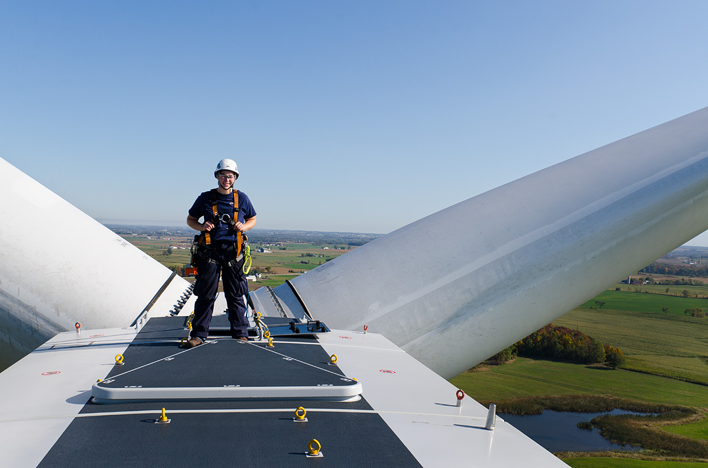
“Solar installer”
is forecast to be the
fastest-growing job
category in the U.S.
through 2026, and
“wind turbine service technician” is second.
https://www.ecosia.org/images
Notes:
The second fastest growing job is wind turbine technician. This is the part of the economy where the millions of new jobs are coming from. This is where we can get sustainable economic growth for the future and put so many people to work.
DESCRIPTION: Text about the future growth of US solar installers and wind turbine service technician jobs and photo of a wind technician walking on a turbine at the Colorado Highlands Wind Farm in Fleming, Colorado, United States, May 5, 2016
ADDITIONAL TALKING POINTS:
The renewable energy sector puts millions to work – and opportunities are growing fast.[1*]
According to International Renewable Energy Agency (IRENA), the renewable energy industry employed 11 million people worldwide in 2018, adding 700,000 jobs from 2017.[2*]
As of 2018, solar remains the largest employer with 3.6 million jobs, followed by biofuels (3.1 million), hydropower (2.1 million), and wind (1.2 million).[2*]
China, Brazil, the US, India, and the EU have the most jobs in renewables. China alone accounted for nearly 40 percent of global renewable energy jobs in 2018.[2*]
The transition to renewables isn’t just helping cut climate-changing emissions – it’s also playing a critical role in supporting sustainable development, improving energy access, and promoting gender equity around the world.[2*]
Manufacturing and construction jobs in the US electricity generation industry are expected to keep growing in coming years, particularly for solar and wind projects.[3*]
In 2018, solar and wind were the top two employers in the electricity generation construction industry, providing about 177,000 and 37,000 jobs, respectively. Natural gas ranked third with around 10,000 jobs.[3*]
Between 2013 and 2018, solar employment grew six times faster than the US industry average. During this period, one in every 124 new jobs was a solar job.[4*]
According to Environmental Entrepreneurs (E2)’s Clean Jobs America report, in 2018, clean energy jobs outnumbered fossil fuel jobs in the US nearly three to one.[5*]
“Solar installer” is projected to be the fastest-growing job in the US through 2026, and “wind turbine service technician” is second, according to the US Bureau of Labor Statistics.[6*]
Energy efficiency is not only an essential tool for reducing emissions – it’s also an engine for job creation and greater productivity.[3*]
The International Energy Agency estimates about $240 billion was invested in energy efficiency across buildings, transport, and industry sectors in 2018.[7*]
IRENA projects that in a business-as-usual scenario, energy efficiency would account for 16.2 million jobs in 2030 (almost a quarter of overall global energy sector jobs). However, IRENA also projects that with more ambitious climate action, efficiency could account for more 25 million jobs (nearly 30 percent of energy sector employment).[8*]
In 2018, the US energy efficiency industry put 2.3 million Americans to work. The sector is projected to grow 7.8 percent in 2019, creating thousands more jobs along the way.[3*]
REFERENCES:
[1*] Arcadia Power, “Renewable energy’s job market continues to grow – with no end in sight,” last accessed July 23, 2019. https://www.arcadiapower.com/energy-101/energy-efficiency/renewable-energy-s-job-market-continues-to-grow-with-no-end-in-sight/
[2*] International Renewable Energy Agency, “Renewable Energy and Jobs Annual Review 2019,” (June 2019). https://www.irena.org/-/media/Files/IRENA/Agency/Publication/2019/Jun/IRENA_RE_Jobs_2019-report.pdf
[3*] National Association of State Energy Officials, “The 2019 U.S. Energy & Employment Report,” (2019). pg. 52 Table 18, pg. 66 Figure 42, pg. 69 Figure 45.https://static1.squarespace.com/static/5a98cf80ec4eb7c5cd928c61/t/5c7f3708fa0d6036d7120d8f/1551849054549/USEER+2019+US+Energy+Employment+Report.pdf
[4*] The Solar Foundation, “2018 National Solar Jobs Census” (2019). https://www.thesolarfoundation.org/national/
[5*] Environmental Entrepreneurs, Clean Jobs America 2019, March 13, 2019. https://www.e2.org/reports/clean-jobs-america-2019/
[6*] US Bureau of Labor Statistics, “Fastest Growing Occupations,” last modified January 30, 2018.
https://www.bls.gov/emp/tables/fastest-growing-occupations.htm
[7*] International Energy Agency, World Energy Investment 2019 (2019). https://webstore.iea.org/download/direct/2738?fileName=WEI2019.pdf
[8*] International Renewable Energy Agency, Global Energy Transformation: A roadmap to 2050 (2018). https://www.irena.org/-/media/Files/IRENA/Agency/Publication/2018/Apr/IRENA_Report_GET_2018.pdf

Slide 15
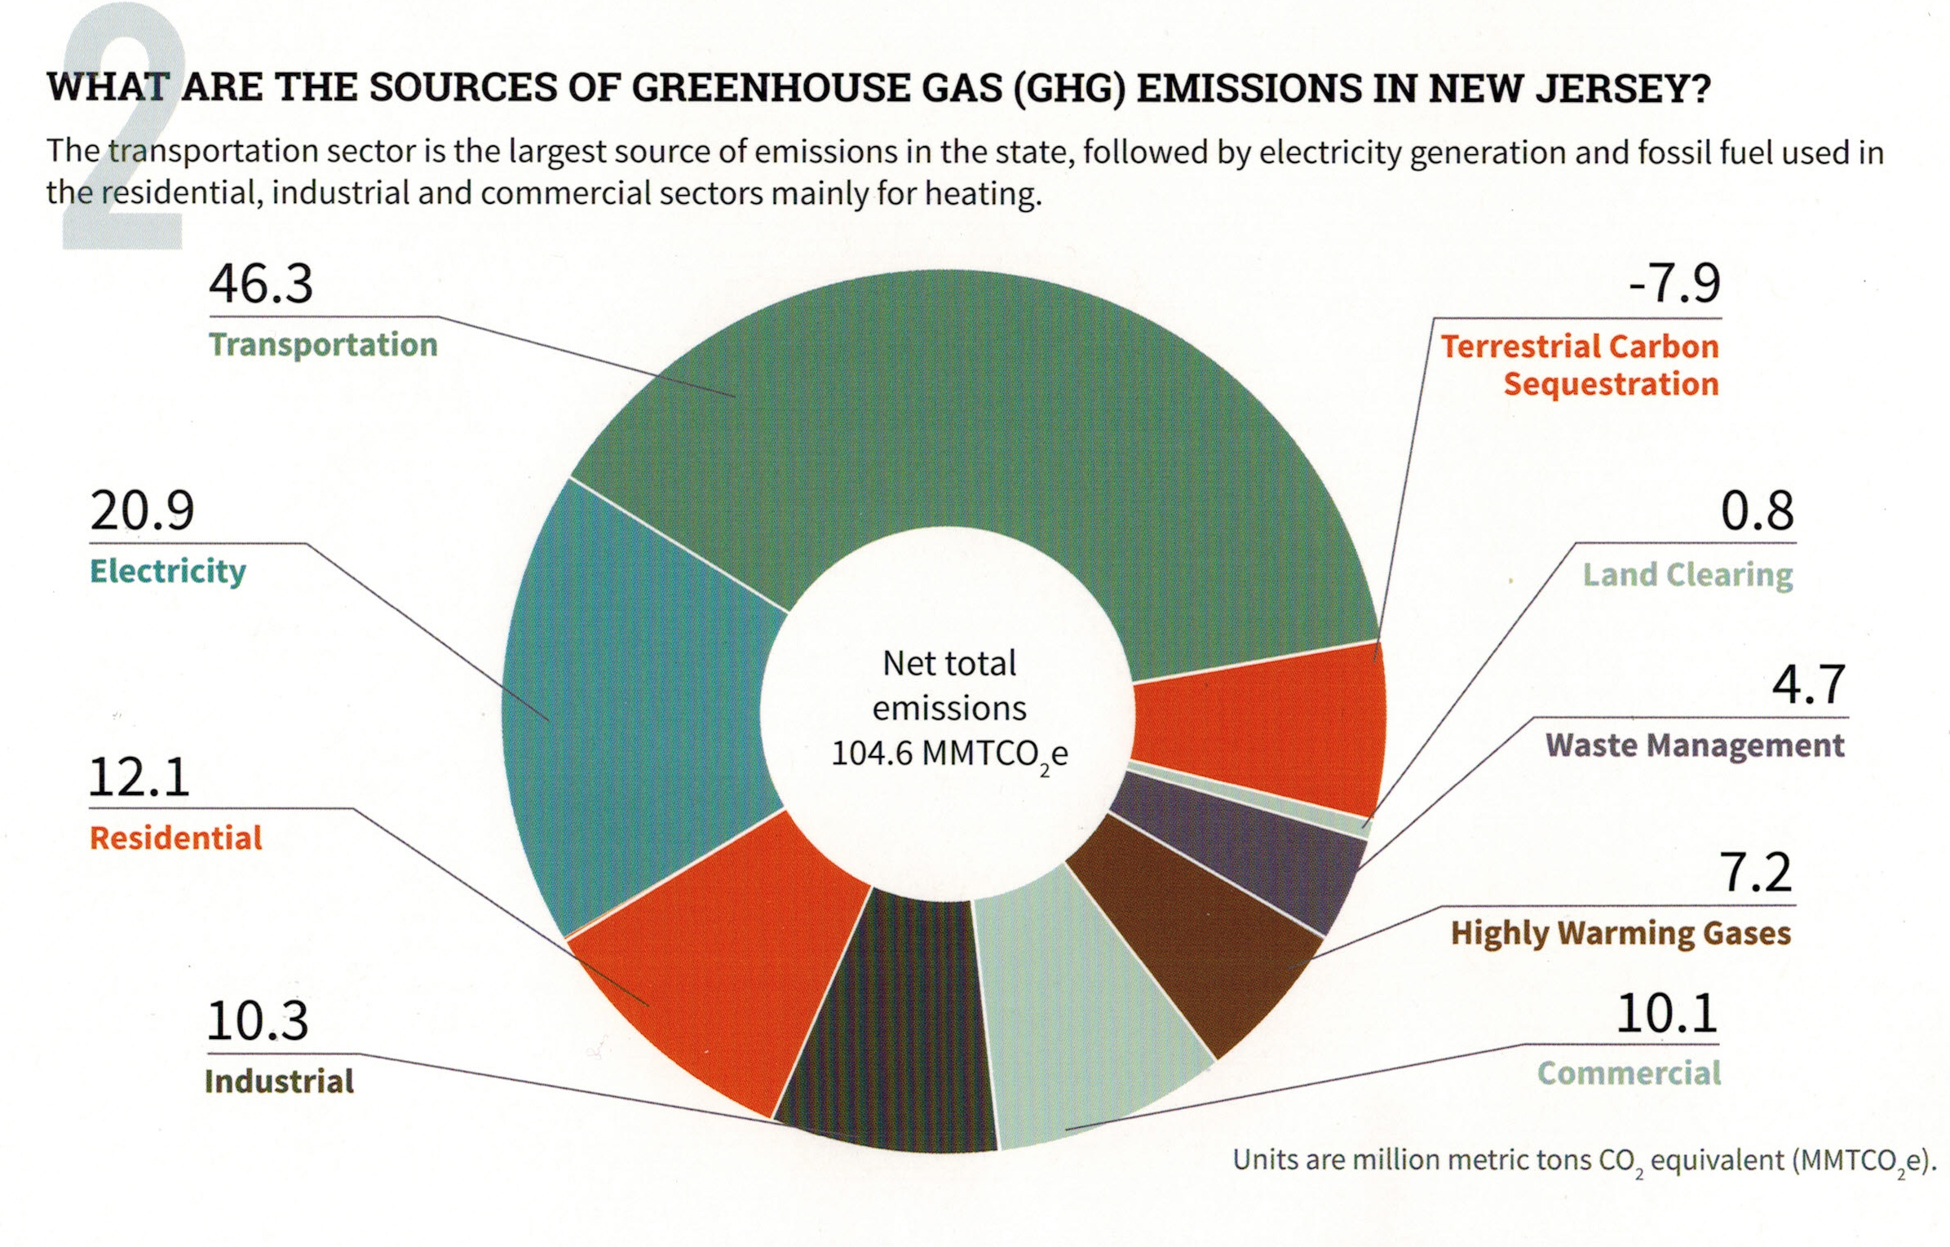
Your (Typical NJ) GHG Emissions EEEmissions
“Reducing NJ Greenhouse Gas Emissions”, Rutgers, Jan 2018
Notes:
This is the NJ “Footprint” of sources of world-heating Greenhouse gases, to show what to tackle first.
Sustainable Jersey states: “the primary goal [of “Gold Star in Energy” is reducing Green House Gases. Responding to this overarching imperative will help achieve all the other [sustainability] goals.”
20% of the GHG is from electricity generation; nearly 50% is from transportation.
Switching electricity to 100% wind/solar, then switching all vehicles to batteries charged by renewable electricity will ELIMINATE almost 70% of our GHG.
VERY IMPORTANT: -8% carbon sequestration by marshes, mudflats, trees, landscaping

Slide 16
NJ Energy Master Plan (EMP) Strategies
Transportation: EVs, public transportation, charging stations
Renewable & Distributed Energy: rooftop & community solar, onshore & offshore wind
Efficiency & Conservation: efficient buildings (insulation, seal air leaks), landscaping to reduce heat, conserve water, or provide food
Buildings: Net-zero carbon buildings – rooftop solar, all-electric space heating & appliances, EV-ready
Notes:
TONIGHT’s visioning focuses on these 5 strategies, found in the NJ 2019 Energy Master Plan.
We need YOUR visioning of what do you expect in an energy plan to enhance YOUR quality of life??
Following are examples of the 5 (These are also printed in front, above the white poster boards)

Slide 17
NJ EMP Strategies, cont.
Environmental Justice Communities: seek local benefit of clean energy transition, prioritize pollution reduction
Modernize the Grid & Utility Infrastructure: smart metering, batteries, bi-directional grid flow, reliability
Clean Energy Innovation Economy: grow world-class research, create jobs, workforce training
Notes:
Finallly, we encourage NJ to MODERNIZE the electrical grid, and to create job training, like here in Brookdale, for future jobs in wind and solar, and energy efficiency opportunities.

Slide 18
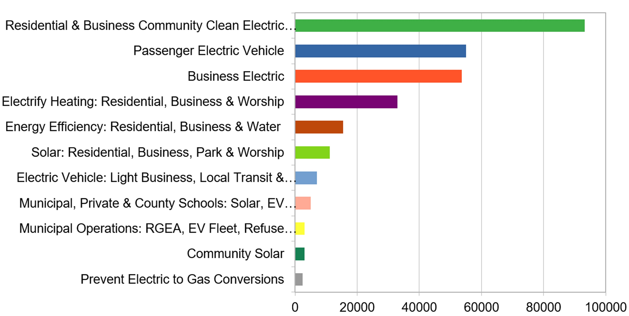
Middletown Energy Plan: GHG emission reductions during year 2030
In 2018, Middletown emissions were 705K Tons (CO2 equiv)- calc per capita of NJ total
266K Tons TotAl CO2 (equivalent) reduction in year 2030
38% reduction of 2018 Emissions
(new Fed and State programs are expected to accelerate reductions to 50% by 2030)
Middletown Energy Plan https://bit.ly/2FZi0ti
Tons CO2 reduction in 2030
Notes:
Start with personal story [show grandkids photo]- I now have 2 grandsons- and want a better life for them. During a 9/15/2020 talk, Joseph Fiordliso, longtime President of the NJ Board of Public Utilities stressed that it is NOW OBVIOUS that our descendants’ lives will be affected by climate change- it will be a different, less friendly life for them.
ASSUMPTIONS on ACCEPTANCE RATES:
Residential (100%) & Business (10%) Community Choice Electric
Passenger Vehicles 25% are electric
Business Electric RPS + 10% for all not otherwise counted
Electrify heating 25%
savings in Energy Efficiency (10%) – consistent with projection from Middletown actual experience
Solar: (10% solar penetration) Residential, Business, park & worship
Delivery trucks ALREADY moving to EV Trucks
Municipal/private/schools: 25% area utilized for solar
Municipal operations: 25% conversations of vehicles to EV & buildings to electric heat

Slide 19
Switch To Clean Electricity
Ask Middletown to supply renewable community choice electrical aggregation
Install rooftop solar
Invest in or subscribe to community solar
Switch to a 100% clean supplier
http://electric.smiller.org
Notes:
You can switch to 100% clean electricity, AND save money, instead of defaulting to 20% clean electric from JCP&L.
Best investment: If you can SOON, pay cash to install rooftop solar.
OR (same GHG reduction): swtich to 100% clean supplier (spend 10 minutes, selecting vendor at URL)
OR – wait a couple of years for investors to build large array “Community Solar” fields – which should prove to be a GREAT investment for you
CLICK

Slide 20
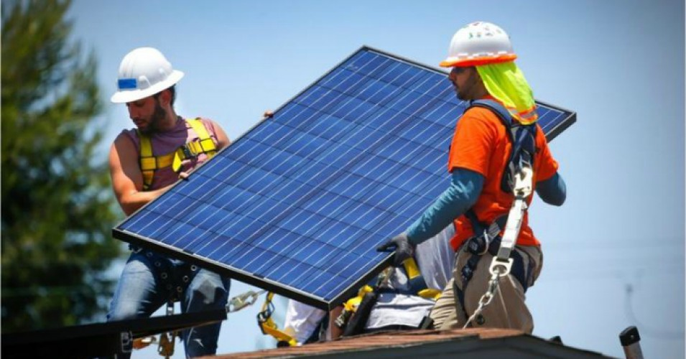
NJ Top 6 Solar States: Solar Panels on 2 Million Homes
Notes:
NJ has dropped a little, but remains #6 in the nation in rooftop solar.
NOTE: NJ is #7, as of Jan, 2021, in overall solar deployment.
Source: https://www.chooseenergy.com/data-center/solar-energy-production-by-state/

Slide 21
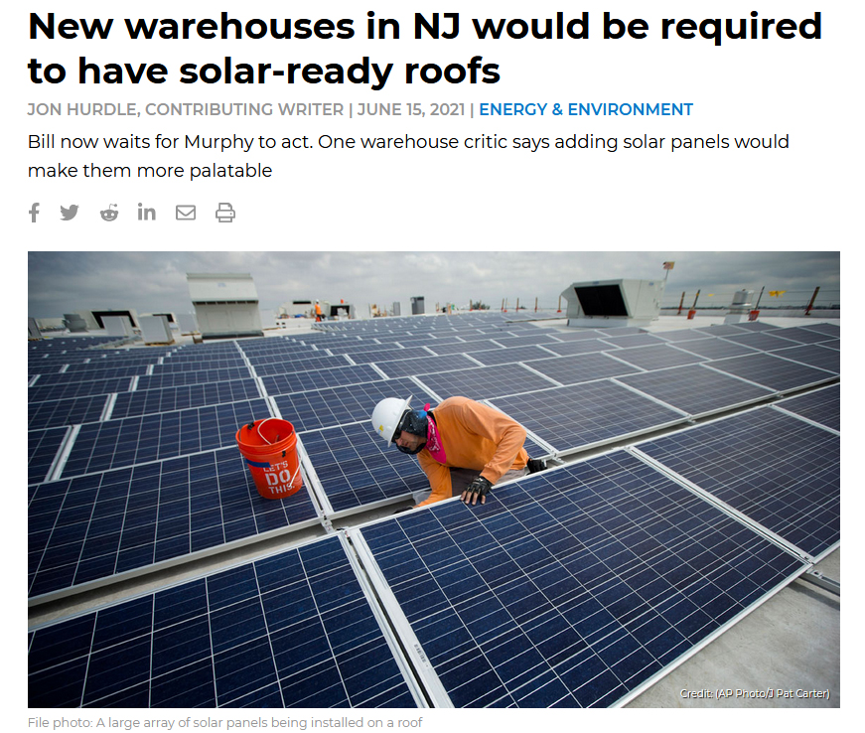
Notes:
NJ Spotlight, 6/15/2021 “File Photo”

Slide 22

California
Starting in 2020, nearly all new homes in California were required to integrate solar energy and energy efficiency solutions.
Notes:
Beginning in 2020, California requires all new construction to integrate solar and higher efficiency. This adds $9,500 to the cost of a new home, but will save $19,000 on electricity over 30 years
REFERENCES:
* James Rainey, "California becomes first state to require solar panels on new homes," NBC News, May 9, 2018. https://www.nbcnews.com/news/us-news/california-becomes-first-state-require-solar-panels-new-homes-n872531
** Mia Nakaji Monnier, "7 Things to Know about California's New Solar Panel Policy," California Magazine (Cal Alumni Association of UC Berkeley), May 31, 2018. https://alumni.berkeley.edu/california-magazine/just-in/2018-05-31/7-things-know-about-californias-new-solar-panel-policy

Slide 23

How Do We Get Clean Energy?
Tree Cover At High Noon – 50 Foot Trees
Notes:
AND/OR – JOIN WITH OTHERS and push for your town to switch ALL residents to 100% renewable Community Choice Electric aggregation. This saves 5 or 10% on electric bill, and has the BIGGEST GHG reduction!

Slide 24
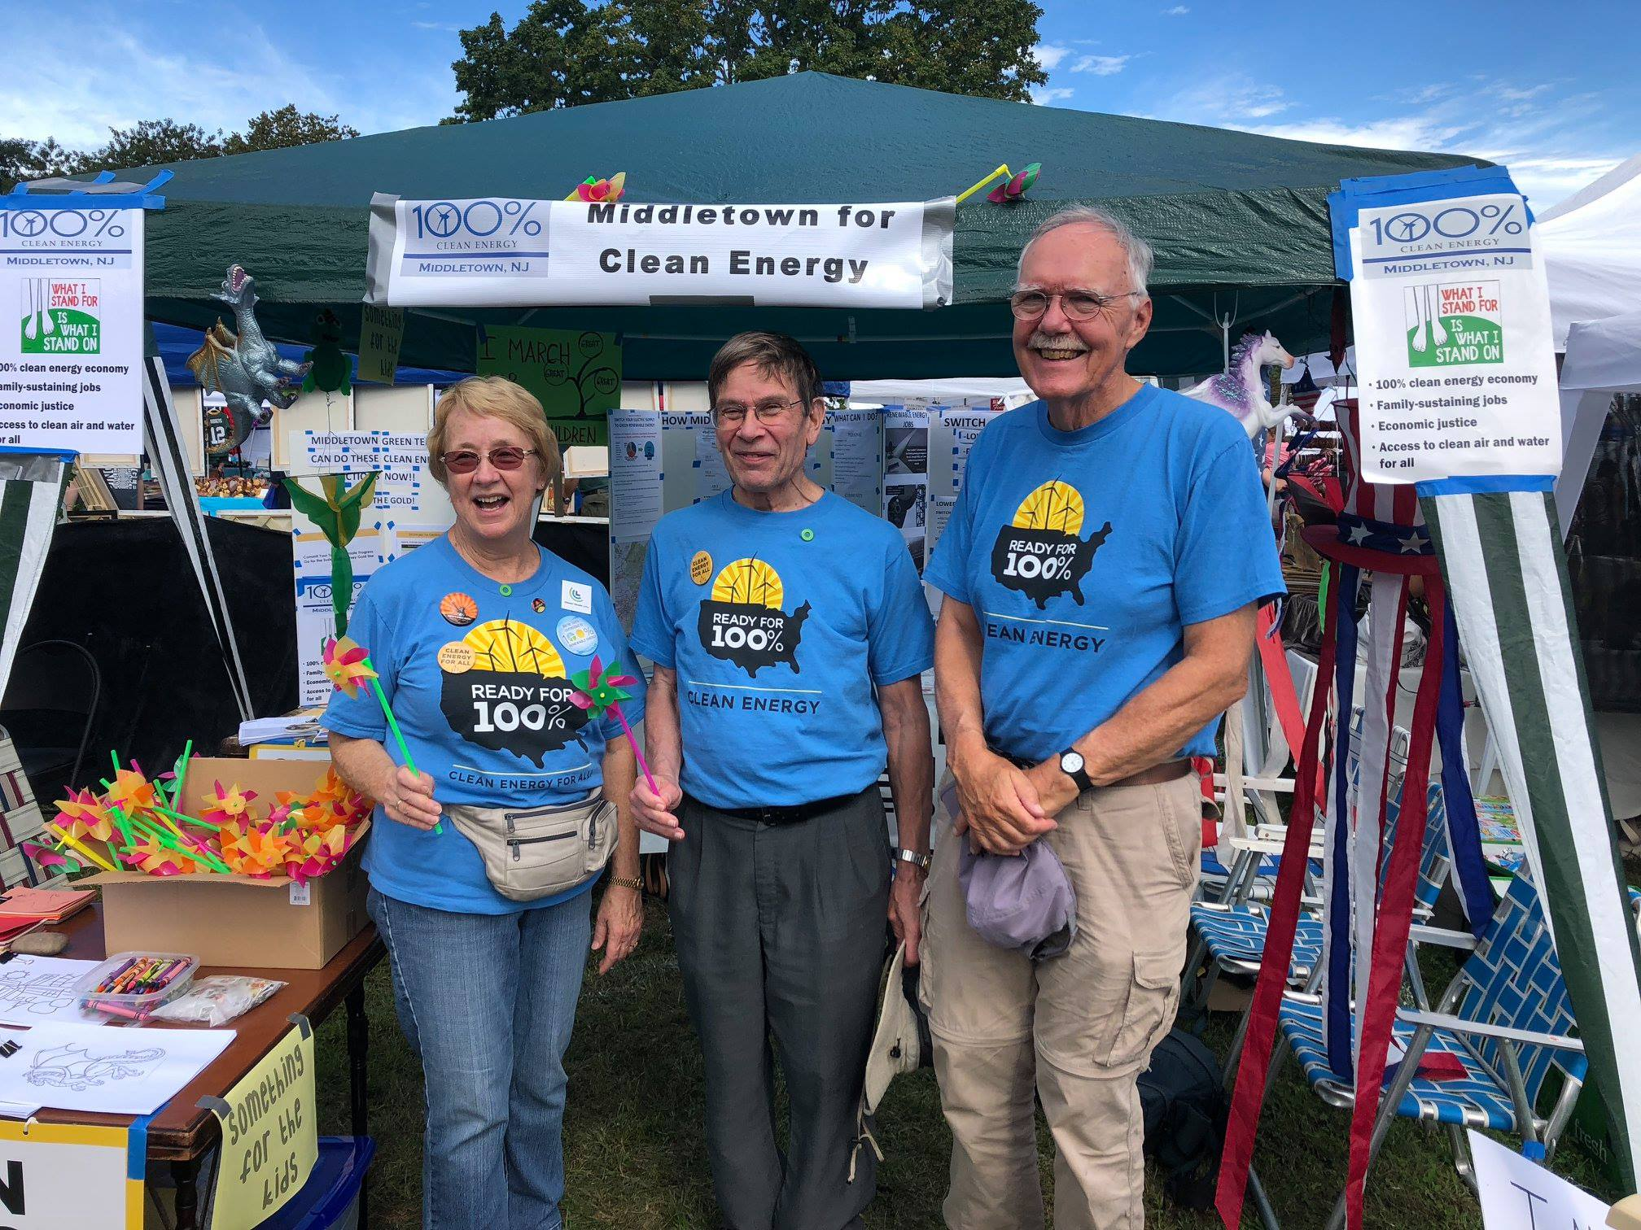
Citizen Action: Lobbying Middletown
Notes:
AND/OR – JOIN WITH OTHERS and push for your town to switch ALL residents to 100% renewable Community Choice Electric aggregation. This saves 5 or 10% on electric bill, and has the BIGGEST GHG reduction!

Slide 25
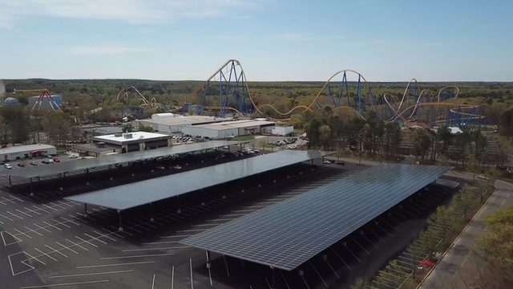
Six Flags Solar Canopy over Parking
Example Community Solar
Notes:
Similarly, Sea Brook Village in TintonFalls (15 acres of solar)
CentraState Hospital, Freehold (26 acres 6.3MW; 8.1 million KWH/Yr.)
In Middletown, we advocate for the Middletown train station parking to be covered with a solar Canopy, like the photo. The Middletown Administrator is using an energy consultant to look into pricing.

Slide 26
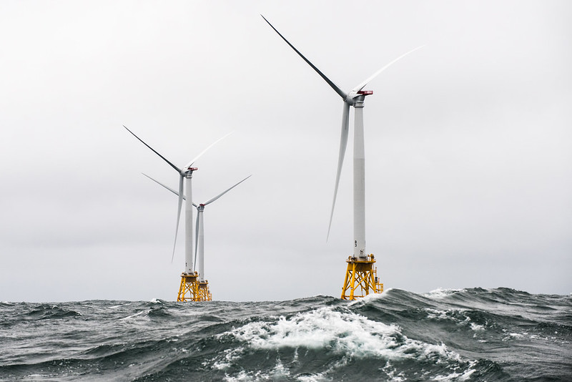
NJ has goal of 7,500 MW from offshore wind by 2035
Notes:
A number of world’s countries have demonstrated they can switch to 100% wind and solar. Read “NJ goal of 3500MW….”In fact, I read those offshore sites have potential for further future expansion by 3 or 4 times the wind power.

Slide 27
Your (Typical NJ) GHG Emissions EEEmissions
“Reducing NJ Greenhouse Gas Emissions”, Rutgers, Jan 2018
Notes:
This is the NJ “Footprint” of sources of world-heating Greenhouse gases, to show what to tackle first.
Sustainable Jersey states: “the primary goal [of “Gold Star in Energy” is reducing Green House Gases. Responding to this overarching imperative will help achieve all the other [sustainability] goals.”
20% of the GHG is from electricity generation; nearly 50% is from transportation.
Switching electricity to 100% wind/solar, then switching all vehicles to batteries charged by renewable electricity will ELIMINATE almost 70% of our GHG.
VERY IMPORTANT: -8% carbon sequestration by marshes, mudflats, trees, landscaping

Slide 28
Switch To Plug-in Electric Vehicle (EV)
Plug Into Your Clean Electricity
Save On Fuel Costs (~30-70% more efficient)
Save On Car Maintenance
Notes:
MAKE YOUR NEXT CAR A PLUG-IN EV!
Save money, and stop the world from continued heating that will severely degrade your own, and descendants’ quality of life

Slide 29
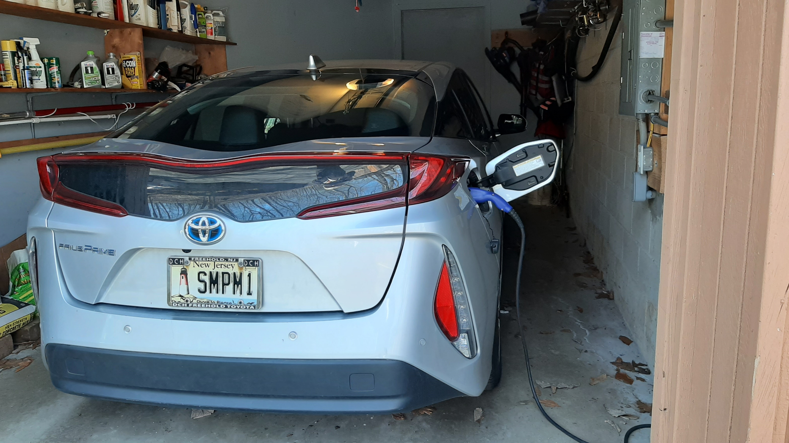
OUR EV – PRIUS PRIME PLUG-IN
Notes:
READ

Slide 30
Global Electric Cars on the Road
Cumulative; Battery and Plug-in Hybrid EVs
Electric Car Stock (Millions)
Data: Global EV Outlook © OECD/IEA 2016
Notes:
ID #4075.F - Can be used in noncommercial online and TV broadcasts of your presentation, but not modified.
… which can cut the global warming pollution there. This is another positive sign.
DESCRIPTION: Graph of the global electric car stock, cumulative of battery and plug-in hybrids between 2010 - 2020
ADDITIONAL TALKING POINTS:
The transportation sector is the second-largest source of global greenhouse gas emissions. To slash emissions and avert catastrophic climate change, we need to transition to cleaner transportation alternatives.[1*]
The danger goes beyond climate impacts: air pollution from vehicle emissions increases the risk of cancer and respiratory issues like asthma and bronchitis.[2*]
Communities of color in the Northeast and Mid-Atlantic United States are exposed to approximately 66 percent more air pollution from vehicles than White residents.[3*]
Globally, vehicle emissions have been linked to approximately 385,000 premature deaths in 2015.[4*]
It took five years to sell the first million electric passenger cars, 17 months to sell the second million, and just six months to get from 3 million to 4 million.[5*]
Though the total volume of electric vehicles (EVs) is still low compared to traditional gas-powered vehicles, EV adoption is skyrocketing – with global sales growing by 46 percent in the first half of 2019, compared to the same period in 2018.[6*]
Much of the recent growth, especially in the US, has been due to the mass production of the Tesla Model 3, which was the highest-selling EV globally in 2019 – making up 13 percent of the global plug-in vehicle market.[7*]
Between 2010–2019, the price of lithium-ion batteries fell by 87 percent, contributing to the increasing competitiveness of EVs.[8*]
When the first mass-market EVs were introduced in 2010, the average cost of a battery pack was $1,000 per kWh. Falling costs meant that by 2017, Tesla’s Model 3 battery packs were only $190 per kWh.[8*], [9*]
f the price of battery packs falls between $125 and $150 per kWh, then EVs are forecast to cost the same or less than internal combustion vehicles. Experts project this will happen by the mid-2020s.[9*]
Some forecasts project the price of battery packs to fall to around $73 per kWh by 2030, as manufacturing methods and materials improve.[9*]
Financial incentives have helped to bridge the gap to make EVs cost-competitive.[10*]
Each of the top-10 countries for electric car registrations has some type of financial incentive in place.[10*]
China, the world’s largest market for electric cars, employs regulatory and purchase incentives that, together, led to nearly 800,000 electric vehicle registrations in 2018.[10*]
Germany, the United Kingdom, Italy, and Romania all offer purchase incentives for electric vehicles. Whereas, the US Norway, and the Netherlands offer tax bonuses, and France offers a combination purchase incentive and scrappage bonus for older non-EVs.[10*]
The US federal government offers a $7,500 consumer tax break for the first 200,000 vehicles an automaker sells. As of the beginning of 2020, only Tesla and General Motors hit the cap.[10*]
With the climate crisis deepening and viable alternatives to gas vehicles increasing, a growing number of countries are planning to phase out combustion engines. Many major auto manufacturers are also developing plans to phase out traditional vehicles and transition to entirely electric lineups.[11*]
Countries like China, India, the UK, and France have all announced plans or intentions to begin phasing out fossil fueled vehicles by 2030 or 2040.[11*]
The trend is similar in the auto manufacturer space:
Daimler (owner of Mercedes-Benz) is accelerating its EV program to have 10 new EVs by 2022.[11*]
All Volvo models introduced in 2019 and after will be hybrid or electric.[11*]
BMW will have 12 new battery electric vehicles (BEVs) and 13 new hybrids by 2025.[11*]
Volkswagen announced that it would attempt to bring 30 or more BEVs to the market by 2025.[11*]
The global electric vehicle market is expected to grow exponentially in the coming years.[12*]
The International Energy Agency projects that by 2030, electric vehicle stock could grow by more than 30 times 2019 levels and reach 245 million electric cars, buses, and trucks.[12*]
The US is projected to see 18.7 million EVs on its roads by 2030, up from 1 million at the end of 2018.[13*]
In 2019, electric buses continued to witness dynamic developments, with about half a million vehicles on the road worldwide.[12*]
REFERENCES:
[1*] International Energy Agency, "CO2 Emissions," last accessed July 2020.
https://www.iea.org/data-and-statistics?country=WORLD&fuel=CO2%20emissions&indicator=CO2%20emissions%20by%20sector
[2*] Union of Concerned Scientists, “Vehicles, Air Pollution, and Human Health,” July 18, 2014. https://www.ucsusa.org/clean-vehicles/vehicles-air-pollution-and-human-health
[3*] Union of Concerned Scientists, “Inequitable Exposure to Air Pollution from Vehicles in the Northeast and Mid-Atlantic,” June 21, 2019. https://www.ucsusa.org/resources/inequitable-exposure-air-pollution-vehicles
[4*] Susan Anenberg, et al., "A global snapshot of the air pollution-related health impacts of transportation sector emissions in 2010 and 2015," (The International Council on Clean Transportation, February 2019). https://theicct.org/publications/health-impacts-transport-emissions-2010-2015
[5*] Bloomberg New Energy Finance, "Cumulative Global EV Sales Hit 4 Million," August 30, 2018. https://about.bnef.com/blog/cumulative-global-ev-sales-hit-4-million/
[6*] Edison Electric Institute, "Electric Vehicle Sales: Facts & Figures," (October 2019). https://www.eei.org/issuesandpolicy/electrictransportation/Documents/FINAL_EV_Sales_Update_Oct2019.pdf
[7*] Zachary Shahan, “Tesla Model 3 Sales = ~4× Nissan LEAF Sales, World’s 2nd Best Selling EV Outside Of China — November EV Sales Report,” CleanTechnica, January 4, 2020.
https://cleantechnica.com/2020/01/04/tesla-model-3-sales-4x-nissan-leaf-sales-worlds-2nd-best-selling-ev-outside-of-china-november-ev-sales-report/
[8*] Veronika Henze, "Battery Pack Prices Fall As Market Ramps Up With Market Average At $156/kWh In 2019," Bloomberg New Energy Finance, December 3, 2019. https://about.bnef.com/blog/battery-pack-prices-fall-as-market-ramps-up-with-market-average-at-156-kwh-in-2019
[9*] Union of Concerned Scientists, “Electric Vehicle Batteries: Materials, Cost, Lifespan,” March 9, 2018. https://www.ucsusa.org/clean-vehicles/electric-vehicles/electric-cars-battery-life-materials-cost
[10*] Volkswagen Aktiengesellschaft, “How electric car incentives around the world work,” May 28, 2019. https://www.volkswagenag.com/en/news/stories/2019/05/how-electric-car-incentives-around-the-world-work.html
[11*] David Roberts, “The world’s largest car market just announced an imminent end to gas and diesel cars,” Vox, September 13, 2017. https://www.vox.com/energy-and-environment/2017/9/13/16293258/ev-revolution
[12*] International Energy Agency, “Global EV Outlook 2020,” June 2020. https://www.iea.org/reports/global-ev-outlook-2020
[13*] Adam Cooper and Kellen Schefter, “Electric Vehicle Sales Forecast and the Charging Infrastructure Required Through 2030,” The Edison Foundation Institute for Electric Innovation and the Edison Electric Institute, November 30, 2018. https://www.edisonfoundation.net/-/media/Files/IEI/publications/IEI_EEI-EV-Forecast-Report_Nov2018.ashx
SLIDE SOURCE(S): https://www.iea.org/reports/global-ev-outlook-2019; https://data.bloomberglp.com/promo/sites/12/678001-BNEF_2020-04-22-ExecutiveFactbook.pdf?link=cta-text

Slide 31
Half of the World’s Buses Will be Electric by 2025
Electric Buses, in Thousands
Data: Bloomberg New Energy Finance
Notes:
Half the world’s buses will be electric by 2025!
ID #5358 - Can be used in noncommercial online and TV broadcasts of your presentation, but not modified.
DESCRIPTION: Graph depicting the real and expected number, in thousands, of electric buses in the world from 2017 to 2025
ADDITIONAL TALKING POINTS: The total number of electric buses in service is forecast to more than triple, from 386,000 last year to about 1.2 million in 2025, equal to about 47 percent of the worldwide city bus fleet, according to a Bloomberg New Energy Finance report released in early 2018. According to this report, China will account for 99 percent of the world’s battery-powered buses.*
REFERENCES:
* Mark Chediak, “Electric Buses Will Take Over Half the World Fleet by 2025,” Bloomberg, February 1, 2018. https://www.bloomberg.com/news/articles/2018-02-01/electric-buses-will-take-over-half-the-world-by-2025

Slide 32
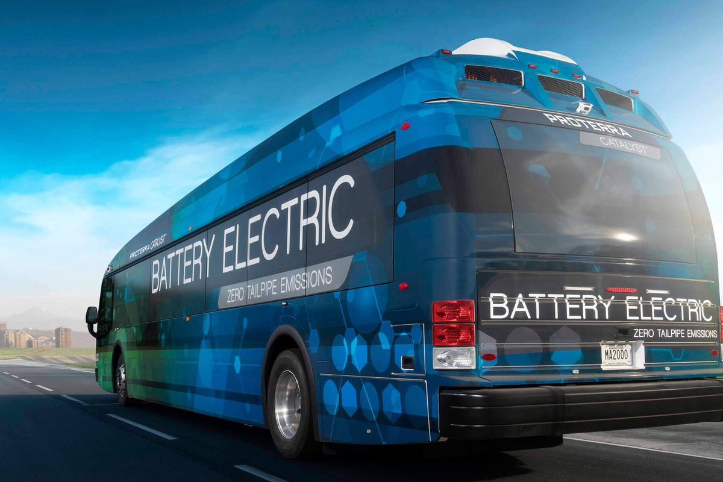
ELECTRIC BUS
Notes:
TRANSPORTATION IS THE LARGEST SOURCE OF GHG EMISSIONS
China is currently making ALL of its buses to be electric- and hopes to be the dominant world-wide electric bus supplier.

Slide 33
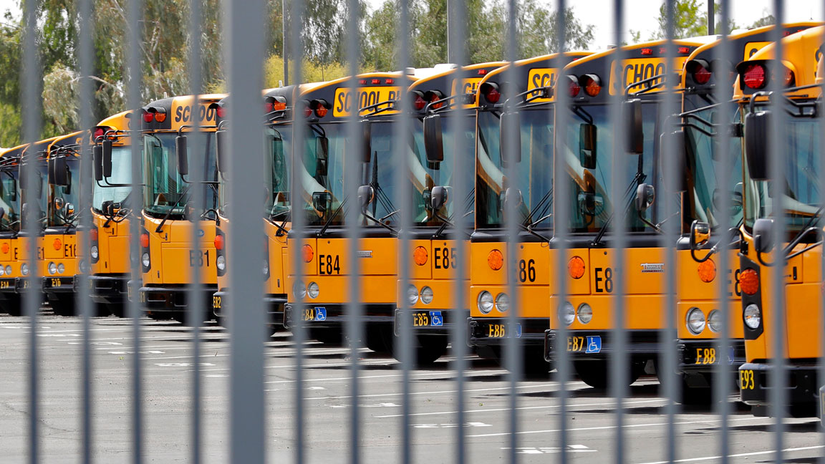
Ditch diesel for electric school buses? NJ advocates say that would pay off in the long run
TOM JOHNSON, ENERGY/ENVIRONMENT WRITER | MARCH 12, 2021 | NJ SPOTLIGHT ENERGY & ENVIRONMENT
Clean-energy supporters say electric buses could supply power back to the grid when not transporting kids

Slide 34

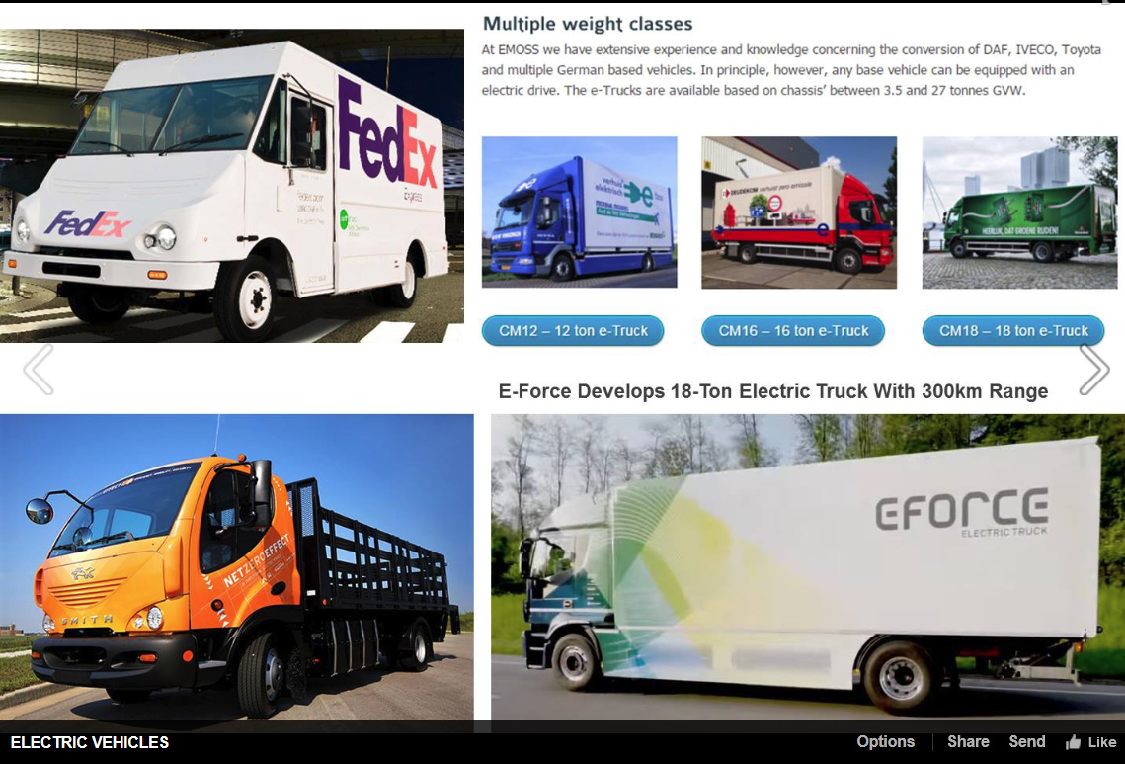
ELECTRIC TRUCKS
USE ARIAL BOLD FONT.
Tesla
Semi truck (9/2017)
Pickup truck (2018)
Volvo
Delivery &
Garbage trucks (5/16/2018)
Self-Driving Semi (9/14/2018)
https://www.ecowatch.com/anheuser-busch-electric-trucks-2640827841.html
Notes:
AND ECONOMICS DICTATES WE WILL HAVE ELECTRIC TRUCKs.
We are moving forward for economic reasons, and because above 2 degrees C rise, much of our world becomes unliveable for our children
CLICK
Anheuser-Busch just announced the purchase of 21 electric “Class 8” trucks to handle its California deliveries.
Building a 1MW solar filed to offset electricity required to charge these trucks
Pledged 25% carbon emission reductions across their entire value chain by 2025

Slide 35

Murphy administration picks up speed getting electric trucks on the road
TOM JOHNSON, ENERGY/ENVIRONMENT WRITER | MAY 21, 2021 | NJ SPOTLIGHT ENERGY & ENVIRONMENT
Proposal to transform dirty-diesel trucks to clean-and-green vehicles welcomed by enviros, meets surprisingly little pushback
Credit: National Renewable Energy Lab via Creative Commons CC BY-NC-ND 2.0

Slide 36

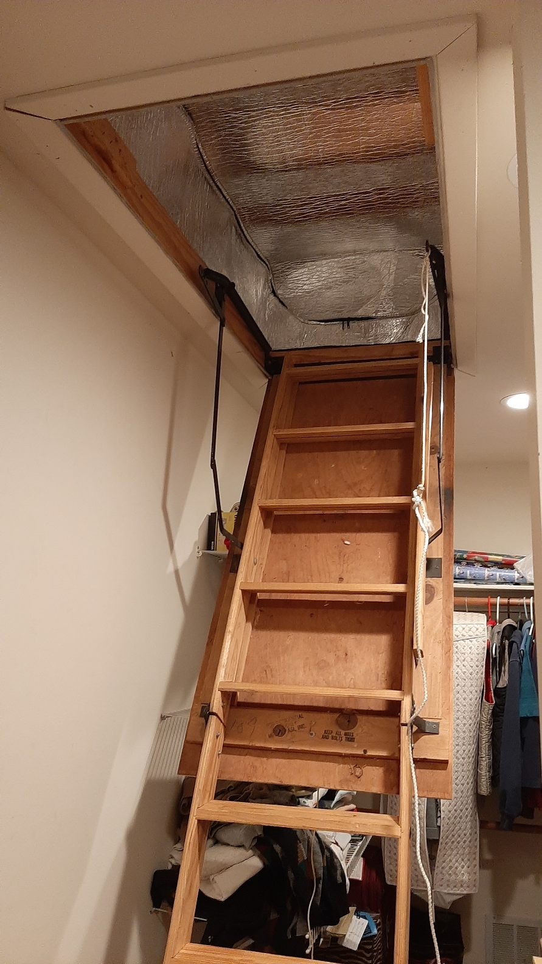
Energy Efficiency – Use Less Energy
Notes:
READ

Slide 37

Space Heating – Switch to Clean Electric
Heat Pump
Notes:
READ

Slide 38

JCP&L “Customer Connection” Newsletter, 5/20/2021

Slide 39
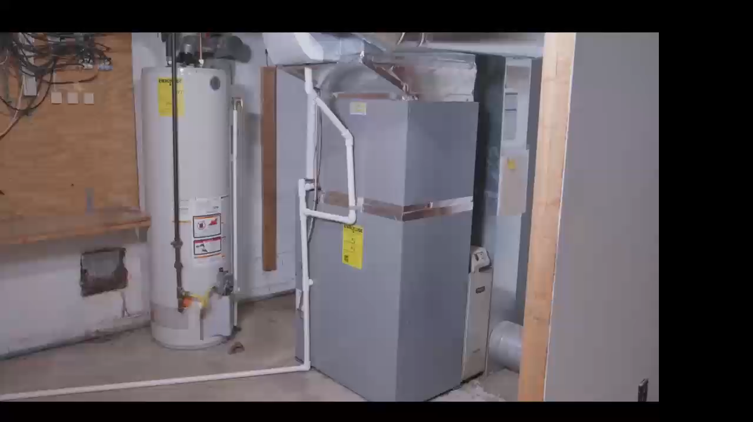

Slide 40
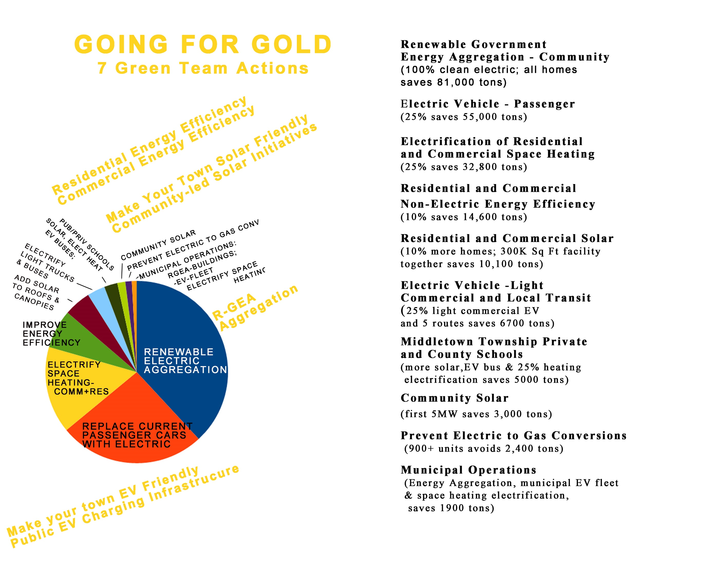

GHG savingS by 2030
MIDDLETOWN 2020
ENERGY PLAN

Slide 41
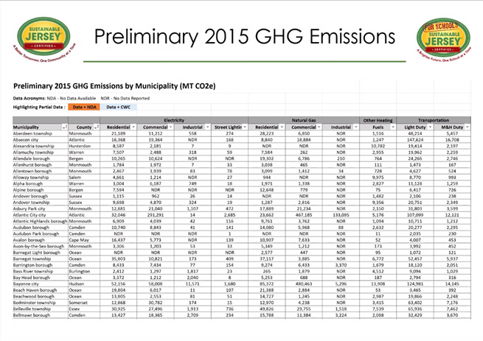
Notes:
AND/OR – JOIN WITH OTHERS and push for your town to switch ALL residents to 100% renewable Community Choice Electric aggregation. This saves 5 or 10% on electric bill, and has the BIGGEST GHG reduction!

Slide 42
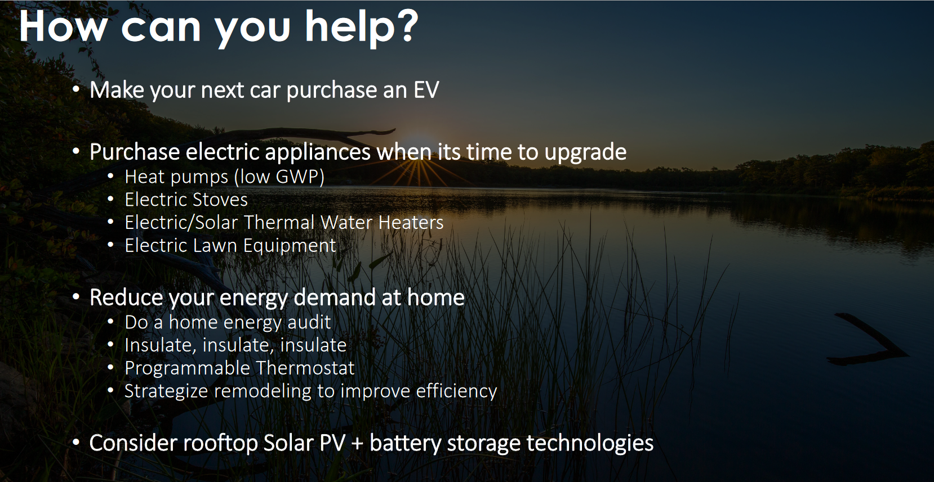
Source: Oct 2020 GWRA Report
Source: Oct, 2020 GWRA Report

Slide 43

MONTAGE VIDEO (silent)

Slide 44


Slide 45
WHAT CAN Middletown GREEN TEAM DO?
Green your own life, so you have a story to tell. And talk about it.
Kick off Sustainable Jersey Energy Actions. Commit to “Gold Star In Energy”.
Add clean energy programs to Master Plan.
Hold education sessions for residents and businesses.
  Personal testimonial works well as example and peer pressure.
  NJCEP is happy to share NJ programs and incentives. Contact Kerri Ann Lombardi for speakers: kerriann.lombardi@clearesult.com; 732-535-0653

Slide 46
THE END

Slide 47
Green Team process for “Testimonials”
Identify residents who want to talk/brag about “Greening their life”
(these “sell” the concepts, so that other residents feel compelled to copy)
Schedule one or more presentation
Ask NJ-CEP coordinator (Kerri Ann Lombardi) to assign a speaker on NJ benefits/incentives
Advertise the Zoom presentation
Rehearse using Zoom (speakers write their own scripts)
Present live (& record for a possible later presentation (in whole, or in part)
Advertise the recorded presentation

Slide 48

Influence Your Town To Adopt Clean Energy
HIDE All these auto manufacturers have EV models available today. And many of them have announced that they will produce ONLY electric vehicles starting sometime in the decade between 2030 and 2040.
FLORIDA
Notes:
AND/OR – JOIN WITH OTHERS and push for your town to switch ALL residents to 100% renewable Community Choice Electric aggregation. This saves 5 or 10% on electric bill, and has the BIGGEST GHG reduction!

Slide 49
Auto Manufacturers Are Moving to Electric Vehicles
Companies with Electric Models in Production
Aixam
Aston Martin
Audi
BAIC
BMW
Bolloré
Buddy Electric
BYD
ChangAn
Chery
Chevy
Citroën
Citydom GmbH
CODA
Daimler
Exagon
Fiat
Fisker
Ford
Geely
GM
Goupil
Honda
Hyundai
JAC
Kandi
Kantanka
Kia
Kyburz
Mahindra
Mercedes-Benz
Mitsubishi
Mullen
NIO
Nissan
Opel
Peugeot
Qiantu
Rayttle
Renault
$mart
Subaru
Tata
Tesla
Toyota
Trumpchi
Venturi
Volkswagen
Zotye
Data: Bloomberg New Energy Finance, EVObsession
Notes:
ID #4842.B - Can be used in noncommercial online and TV broadcasts of your presentation, but not modified.
In transportation, we're seeing the beginnings of a massive shift to electric vehicles, …
DESCRIPTION: Text slide listing auto manufacturers with an electric model in production
ADDITIONAL TALKING POINTS:
The transportation sector is the second-largest source of global greenhouse gas emissions. To slash emissions and avert catastrophic climate change, we need to transition to cleaner transportation alternatives.[1*]
The danger goes beyond climate impacts: air pollution from vehicle emissions increases the risk of cancer and respiratory issues like asthma and bronchitis.[2*]
Communities of color in the Northeast and Mid-Atlantic United States are exposed to approximately 66 percent more air pollution from vehicles than White residents.[3*]
Globally, vehicle emissions have been linked to approximately 385,000 premature deaths in 2015.[4*]
It took five years to sell the first million electric passenger cars, 17 months to sell the second million, and just six months to get from 3 million to 4 million.[5*]
Though the total volume of electric vehicles (EVs) is still low compared to traditional gas-powered vehicles, EV adoption is skyrocketing – with global sales growing by 46 percent in the first half of 2019, compared to the same period in 2018.[6*]
Much of the recent growth, especially in the US, has been due to the mass production of the Tesla Model 3, which was the highest-selling EV globally in 2019 – making up 13 percent of the global plug-in vehicle market.[7*]
Between 2010–2019, the price of lithium-ion batteries fell by 87 percent, contributing to the increasing competitiveness of EVs.[8*]
When the first mass-market EVs were introduced in 2010, the average cost of a battery pack was $1,000 per kWh. Falling costs meant that by 2017, Tesla’s Model 3 battery packs were only $190 per kWh.[8*], [9*]
f the price of battery packs falls between $125 and $150 per kWh, then EVs are forecast to cost the same or less than internal combustion vehicles. Experts project this will happen by the mid-2020s.[9*]
Some forecasts project the price of battery packs to fall to around $73 per kWh by 2030, as manufacturing methods and materials improve.[9*]
Financial incentives have helped to bridge the gap to make EVs cost-competitive.[10*]
Each of the top-10 countries for electric car registrations has some type of financial incentive in place.[10*]
China, the world’s largest market for electric cars, employs regulatory and purchase incentives that, together, led to nearly 800,000 electric vehicle registrations in 2018.[10*]
Germany, the United Kingdom, Italy, and Romania all offer purchase incentives for electric vehicles. Whereas, the US Norway, and the Netherlands offer tax bonuses, and France offers a combination purchase incentive and scrappage bonus for older non-EVs.[10*]
The US federal government offers a $7,500 consumer tax break for the first 200,000 vehicles an automaker sells. As of the beginning of 2020, only Tesla and General Motors hit the cap.[10*]
With the climate crisis deepening and viable alternatives to gas vehicles increasing, a growing number of countries are planning to phase out combustion engines. Many major auto manufacturers are also developing plans to phase out traditional vehicles and transition to entirely electric lineups.[11*]
Countries like China, India, the UK, and France have all announced plans or intentions to begin phasing out fossil fueled vehicles by 2030 or 2040.[11*]
The trend is similar in the auto manufacturer space:
Daimler (owner of Mercedes-Benz) is accelerating its EV program to have 10 new EVs by 2022.[11*]
All Volvo models introduced in 2019 and after will be hybrid or electric.[11*]
BMW will have 12 new battery electric vehicles (BEVs) and 13 new hybrids by 2025.[11*]
Volkswagen announced that it would attempt to bring 30 or more BEVs to the market by 2025.[11*]
The global electric vehicle market is expected to grow exponentially in the coming years.[12*]
The International Energy Agency projects that by 2030, electric vehicle stock could grow by more than 30 times 2019 levels and reach 245 million electric cars, buses, and trucks.[12*]
The US is projected to see 18.7 million EVs on its roads by 2030, up from 1 million at the end of 2018.[13*]
In 2019, electric buses continued to witness dynamic developments, with about half a million vehicles on the road worldwide.[12*]
REFERENCES:
[1*] International Energy Agency, "CO2 Emissions," last accessed July 2020.
https://www.iea.org/data-and-statistics?country=WORLD&fuel=CO2%20emissions&indicator=CO2%20emissions%20by%20sector
[2*] Union of Concerned Scientists, “Vehicles, Air Pollution, and Human Health,” July 18, 2014. https://www.ucsusa.org/clean-vehicles/vehicles-air-pollution-and-human-health
[3*] Union of Concerned Scientists, “Inequitable Exposure to Air Pollution from Vehicles in the Northeast and Mid-Atlantic,” June 21, 2019. https://www.ucsusa.org/resources/inequitable-exposure-air-pollution-vehicles
[4*] Susan Anenberg, et al., "A global snapshot of the air pollution-related health impacts of transportation sector emissions in 2010 and 2015," (The International Council on Clean Transportation, February 2019). https://theicct.org/publications/health-impacts-transport-emissions-2010-2015
[5*] Bloomberg New Energy Finance, "Cumulative Global EV Sales Hit 4 Million," August 30, 2018. https://about.bnef.com/blog/cumulative-global-ev-sales-hit-4-million/
[6*] Edison Electric Institute, "Electric Vehicle Sales: Facts & Figures," (October 2019). https://www.eei.org/issuesandpolicy/electrictransportation/Documents/FINAL_EV_Sales_Update_Oct2019.pdf
[7*] Zachary Shahan, “Tesla Model 3 Sales = ~4× Nissan LEAF Sales, World’s 2nd Best Selling EV Outside Of China — November EV Sales Report,” CleanTechnica, January 4, 2020.
https://cleantechnica.com/2020/01/04/tesla-model-3-sales-4x-nissan-leaf-sales-worlds-2nd-best-selling-ev-outside-of-china-november-ev-sales-report/
[8*] Veronika Henze, "Battery Pack Prices Fall As Market Ramps Up With Market Average At $156/kWh In 2019," Bloomberg New Energy Finance, December 3, 2019. https://about.bnef.com/blog/battery-pack-prices-fall-as-market-ramps-up-with-market-average-at-156-kwh-in-2019
[9*] Union of Concerned Scientists, “Electric Vehicle Batteries: Materials, Cost, Lifespan,” March 9, 2018. https://www.ucsusa.org/clean-vehicles/electric-vehicles/electric-cars-battery-life-materials-cost
[10*] Volkswagen Aktiengesellschaft, “How electric car incentives around the world work,” May 28, 2019. https://www.volkswagenag.com/en/news/stories/2019/05/how-electric-car-incentives-around-the-world-work.html
[11*] David Roberts, “The world’s largest car market just announced an imminent end to gas and diesel cars,” Vox, September 13, 2017. https://www.vox.com/energy-and-environment/2017/9/13/16293258/ev-revolution
[12*] International Energy Agency, “Global EV Outlook 2020,” June 2020. https://www.iea.org/reports/global-ev-outlook-2020
[13*] Adam Cooper and Kellen Schefter, “Electric Vehicle Sales Forecast and the Charging Infrastructure Required Through 2030,” The Edison Foundation Institute for Electric Innovation and the Edison Electric Institute, November 30, 2018. https://www.edisonfoundation.net/-/media/Files/IEI/publications/IEI_EEI-EV-Forecast-Report_Nov2018.ashx
SLIDE SOURCE(S): https://evobsession.com/electric-car-sales/

Slide 50
Our Choice for Now
Switch to a 100% clean supplier; save ~10%
Also Work On
Continue to ask Middletown to supply renewable community choice electrical aggregation
Look (in 2022) for opportunities to invest in or subscribe to community solar
Notes:
You can switch to 100% clean electricity, AND save money, instead of defaulting to 20% clean electric from JCP&L.
Best investment: If you can SOON, pay cash to install rooftop solar.
OR (same GHG reduction): swtich to 100% clean supplier (spend 10 minutes, selecting vendor at URL)
OR – wait a couple of years for investors to build large array “Community Solar” fields – which should prove to be a GREAT investment for you
CLICK

Slide 51

New Jersey Renewable Government Energy (Electric) Aggregation (R-GEA) for Community
Also called Community Choice Aggregation
Most effective carbon reduction action: accounts for 40% of potential savings of first decade actions in our Middletown Energy Plan
Provides cost savings to residents; low or no cost to Middletown
Notes:
For last 3 years, I have maintained a price-ranked list of 3rd party suppliers of renewable electricity

